Slide 1


Factors and Factorials Session No.: Course Name: Course Code: O1UA422L Instructor Name: Duration: 50 Mins Date of Conduction of Class:

Slide 2

Learning Outcome:
Learning Outcome 1: Analyze and determine the number of factors, including odd and even factors, of a given number.
Learning Outcome 2: Apply factorial properties to solve problems involving trailing zeroes and highest power of a prime dividing n!

Slide 3
Factors
Concepts of Factors and Multiples
Number of factors and Number of odd and even factors
Sum of factors
Product of factors
Perfect Square and Perfect Cube factors
Factorials
Concept of Number of Zeros
Highest power of a number in a factorial
Number of zeroes in a factorial
Miscellaneous Problems

Slide 4
FACTORS
Factors: A factor of a number is an integer that divides the number completely leaving zero as remainder.
Example:
Factors of 12:- 1, 2, 3, 4, 6, 12
(because 12÷1=12, 12÷2=6, 12÷3=4, 12÷4=3, etc.)
Multiples: A given number which can be divided by another number completely leaving zero as remainder, is called a multiple of another number.
Example: 12 is multiple of 1,2,3,4,6,12

Slide 5
FACTORS
Prime Factorization: Breaking down a number into its prime factors.
Example: 24= 2*2*2*3 = 2³×3¹.
If N=Pª₁×P^{b}₂×⋯×P^{m}_{k}
Where P₁,P₂,P₃……P_{k} are Prime Numbers
then Number of factors is :- (a+1)(b+1)…(m+1)
Example: 24= = 2³×3¹ →
Number of factors = (3+1)(1+1)=8

Slide 6
FACTORS
Q 1. How many factors are there in 2⁶ x 3³ x 7³ ?
120 b) 122 c)126 d)112
Q 2. How many factors of the number 2⁸ x 3⁶ x 5⁴ x 10⁵ are there?
594 b) 420 c) 628 d) 980
Q 3. How many factors are there in 2560?
a) 20 b) 22 c)26 d)30
Notes:
Answer: 1d 2b 3a

Slide 7
FACTORS
Number of even Factors and odd factors:
Let N is a number.
N=Pª₁×P^{b}₂× P^{c}₃ ⋯×P^{m}_{k}
Now suppose that P₁ is only even prime no-2 anP₂,P_{3….}P_{m} are odd prime numbers in prime factorization of N
Odd no of factors = 1* (b+1)(c+1)….(m+1) (Consider power of 2 or Pª₁ as 1)
Even no of factors = (total no of factors) - (odd no of factors).
or
a*(b+1)(c+1)….(m+1)
(Take power of 2 as it is and add 1 in other powers and multiply)

Slide 8
FACTORS
Q 4. Find how many Even and Odd factors are there in 2⁶ x 3³ x 7³ ?
Q 5. Find how many Even and Odd factors are there in 2⁸ x 3⁶ x 5⁴ x 10⁵ ?
Q 6. Find how many Even and Odd factors are there in 2560?
Notes:
4. odd 16 even 96 5. odd 42 even 378 6. odd 2 even 18

Slide 9
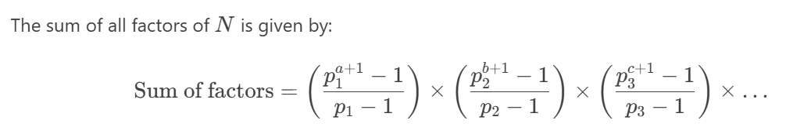
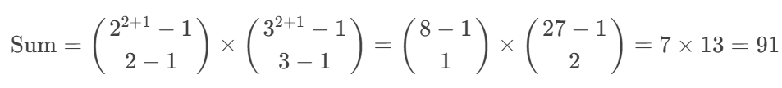
FACTORS
Let N is a number.
N=Pª₁×P^{b}₂× P^{c}₃ ⋯×P^{m}_{k}
Example:- N=36 : - 2²×3²
List all factors of 36:- 1, 2, 3, 4, 6, 9, 12, 18, 36 Sum: 1+2+3+4+6+9+12+18+36=91

Slide 10
FACTORS
Let N is a number.
N=Pª₁×P^{b}₂× P^{c}₃ ⋯×P^{m}_{k}
Sum of Factors:- ( P⁰₁+ P¹₁+ P²₁+…. Pª₁)× ( P⁰₂+ P¹₂+ P²₂+…. P^{b}₂ ) x ( P⁰₃+ P¹₃+ P²₃+…. P^{c}₃ )…….
Example:- N=36 : - 2²×3²
2²×3²= (2⁰+ 2¹+ 2²) x (3⁰+ 3¹+ 3²)
7x13 = 91
List all factors of 36:- 1, 2, 3, 4, 6, 9, 12, 18, 36 Sum: 1+2+3+4+6+9+12+18+36=91

Slide 11
FACTORS
Q 7. Find the sum of the factors of 2⁶ x 3³ x 7³ ?
Q 8. Find the sum of the factors of 2⁸ x 3⁶ x 5⁴ x 10⁵ ?
Q 9. Find the sum of the factors of 2560?
Notes:
7. 2032000 8. 1023*1093*3906 = 4367450934 9. 6138

Slide 12
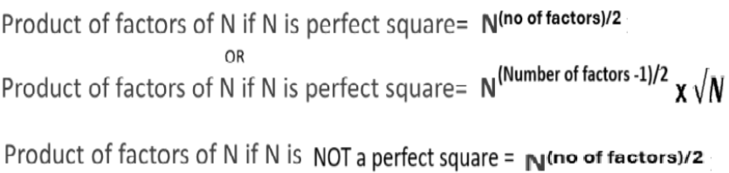
FACTORS

Slide 13
FACTORS
Q 10. Find the product of factors of 2⁶ x 3³ x 7³ ?
Q 11. Find the product of factors of 2⁸ x 3⁶ x 5⁴ x 10⁵ ?
Q 12. Find the product of factors of 25600?
Notes:
10. ( 2⁶ x 3³ x 7³)⁵⁶ 11. (2⁸ x 3⁶ x 5⁴ x 10⁵)²¹⁰ 12. (25600)¹⁶ x 160

Slide 14
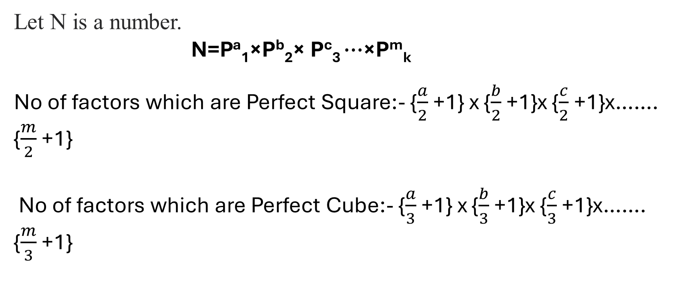
FACTORS
Please see the remarks on how to use these formulae in the next slide.

Slide 15
FACTORS
Consider the integer part of fractions only and the decimal part is to be ignored.
Example: How many factors of 24 are perfect square?
Solution: 24 = 2^{3`} x3¹
therefore, no. of factors which are perfect squares= (3/2+1)(½+1)
=(1.5+1)(0.5+1)
Now ignore 0.5 in both the brackets
i.e. (1+1)(1) = 2
Example: How many factors of 12 are perfect cube?
Solution: 12 = 2^{2`} x3¹
therefore, no. of factors which are perfect cubes= (2/3+1)(½+1)
=(0.6+1)(0.5+1)
Now ignore 0.6 and 0.5
i.e. (1)(1) = 1
Notes:
10. ( 2⁶ x 3³ x 7³)⁵⁶ 11. (2⁸ x 3⁶ x 5⁴ x 10⁵)²¹⁰ 12. (25600)¹⁶ x 160

Slide 16
FACTORS
Q 13. Find how many factors of 2⁶ x 3³ x 7³ are perfect square and perfect cube?
Q 14. Find how many factors of 2⁸ x 3⁶ x 5⁴ x 10⁵ are perfect square and perfect cube?
Q 15. Find how many factors of 25600 are perfect square and perfect cube?
Notes:
13. 16 and 12 14. 60 and 24 15. 12 and 4

Slide 17
FACTORS
How many factors of the number 2⁸ x 3⁶ x 5⁴ x 10⁵ are multiples of 120?
Explanation:- 120 can be prime-factorized as 2³ x 3 x 5.
Given number can be written as multiples of 120 will be of the form :- 2^3 x 3 x 5 x K. 2¹³ x 3⁶ x 5⁹ = 2³ x 3 x 5 x K => K = 2¹⁰ X 3⁵ X 5⁸. The number of factors of N that are multiples of 120 is identical to the number of factors of K. Number of factors of K = (10 + 1) x (5 + 1) x (8 + 1) = 11 X 6 X 9 = 594

Slide 18
FACTORIALS
The factorial of a non-negative integer n, denoted by n!, is the product of all positive integers from 1 to n.
n!=n×(n−1)×(n−2)×⋯×2×1
n!=n×(n−1)!
Examples:
4!=4×3×2×1=24
5!=5×4!=5×24=120
0!=1 (by definition)

Slide 19
FACTORIALS
Number of Trailing Zeroes or Power of 10: It is very easy to find the number of zero at the end , all you have to do is count how many times does 2 and 5 occur in the question as factor. Number of zeros is equal to the one (2 or 5)which occurred less times. i.e. 2*5 = 10 or 2*2*5*5 = 100 So the number of zeros depends upon the number of pairs of 2 and 5. Example 1. How many numbers of zeros will be there at the trail (end) of the 1*2*3*4*5*6*7*8*9*10? Solution: In given expression number of 2’s = 8 Number of 5’s = 2 So total number of pairs = 2 Two zeroes will be there at the end of the calculation.

Slide 20
FACTORIALS
Number of Trailing Zeroes in any Factorial: As we know the number of Trailing zeros depends upon the number of pairs of 2 and 5 and no of pairs will be equal to lowest power of 2 or 5. So in any factorial it is obvious that power of 5 will be less as compared to power of 2. So we only calculate Power of 5 which will give no of pairs or no of Trailing Zeroes.
Power of 5 in any N!:-
Step-1:- Divide N by 5 and take the floor value.
Step-2:- Divide N by 5²or 25 and take the floor value.
Step-3:- Continue for higher powers of 5 (125,625,…125,625,…) until the division result is less than 1.
Step-4 Sum all the results to get the power of 5 which will finally give total number of trailing zeros.

Slide 21
FACTORIALS
Q-1 What is number of trailing zeros in 350!?
Q-2. What is the highest power of 5 that divide
90 x 80 x 70 x 60 x 50 x 40 x 30 x 20 x 10
Q-3 Find the number of zeros at the end of 2^7 × 3^5 × 5^8 × 7^5 × 8^3 × 10^5.
Q-4 How many trailing zeros does 60! have?
Q-5. Find the number of zeros in 532! ?
Notes:
1- 86 2- 5^10 3- 13 4- 14 5- 131

Slide 22
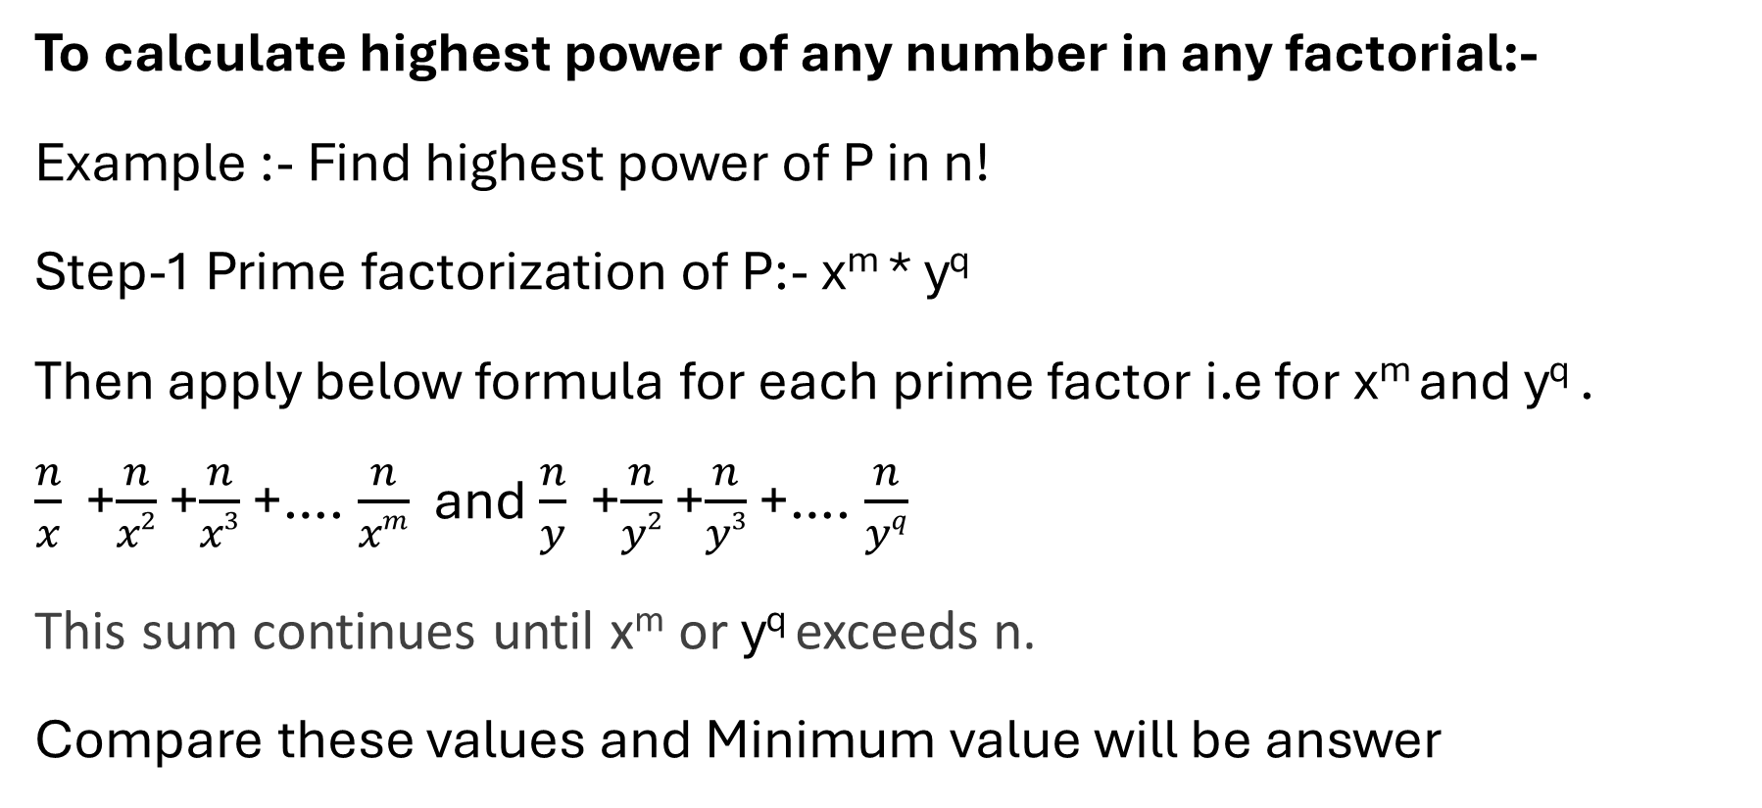
FACTORIALS

Slide 23
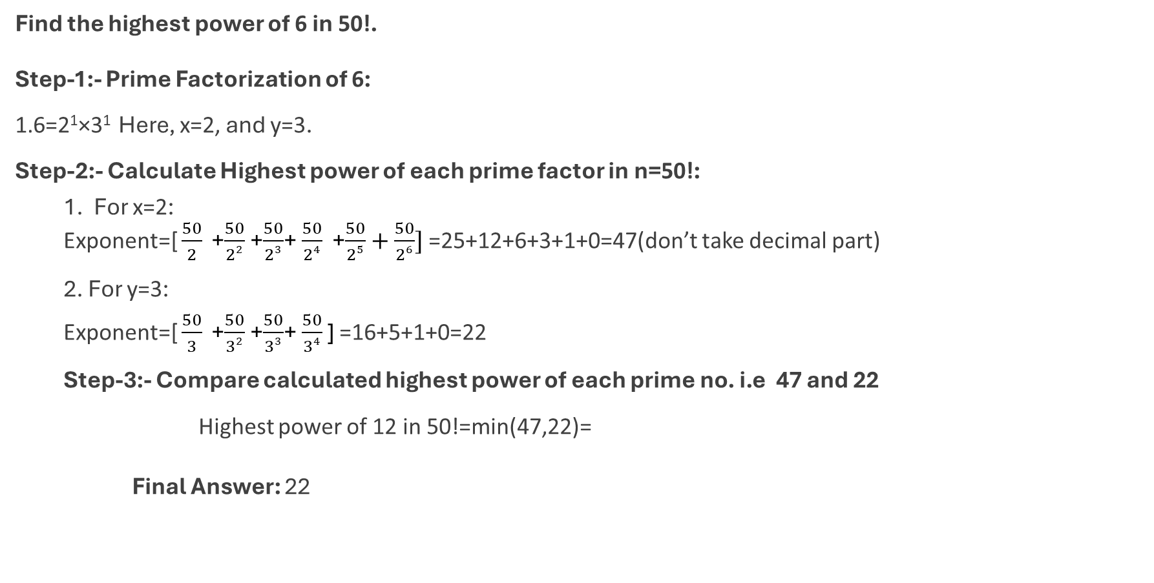
FACTORIALS

Slide 24
FACTORIALS
Q 6. What is the highest power of 12 that divides 54!
Q-7. How many values can natural number n take, if n! is a multiple of 2^20 but not 3^20?
Notes:
6- 25 7- 21

Slide 25
Practice Questions

Slide 26
FACTORS
Factors:
1. How many numbers can divide 504?
24 (b) 30 (c) 28 (d) 3
2. How many factors of 504 are odd?
7 (b) 6 (c) 2 (d) 5
3. How many factors of 504 are even?
17 (b) 16 (c) 4 (d) 18
Notes:
Answer:- 1-a, 2-b, 3-d

Slide 27
FACTORS
4. How many factors of 504 are multiples of 12?
10 (b) 6 (c) 12. (d) 8
5. What is the sum of the factors of 504?
(a) 1000 (b) 1560 (c) 1280 (d) 910
6. How many factors of 504 are perfect square and perfect cube respectively?
4 and 2 (b) 3 and 2 (c) 4 and 3 (d) 3 and 3
7. What is the multiply of the factors of 504?
(a) 100^54 (b) 1560^32 (c) 1280^12 (d) 504^12
Notes:
Answer:- 4-d, 5-b, 6-a, 7-d

Slide 28
Q8. How many trailing zeros (zeros at the end of the number) does 80! have? (a) 19 (b) 16 (c) 8 (d) 18
Notes:
Answer-a

Slide 29
Q9. What is the highest power of 12 that divides 60!? (a) 5 (b) 28 (c) 30 (d) 4
Notes:
Answer - b

Slide 30
Q10. Find the highest power of 30 in 50! (a) 12 (b) 14 (c) 16 (d) 18
Notes:
Answer- A

Slide 31
Q11. Which digit from the right end of 933! is the first non-zero digit?
300th (b) 232nd
(c) 400th (d) 320th
Notes:
Answer- B

Slide 32
Ensure attainment of LOs in alignment to the learning activities: outcomes (1-2)
Outcome 1: Students are able to calculate total factors, odd factors, and even factors of a given number.
Outcome 2: Students can solve factorial-based problems such as trailing zeroes and highest power of a prime dividing a factorial, relevant to aptitude tests.

Slide 33
Information about the next lesson

Slide 34
Review and Reflection from students

